Slide 1

Programing Languages Seminar
Stav Suzan Rabinovich
Lecturer : Dr. Yitzhak Aviv
January 2022

Slide 2
Goals & Achievements
> Develop GUI with Python’s Tkinter.
> Using SQL queries with SQLite3.
> Used Chinook database.

Slide 3
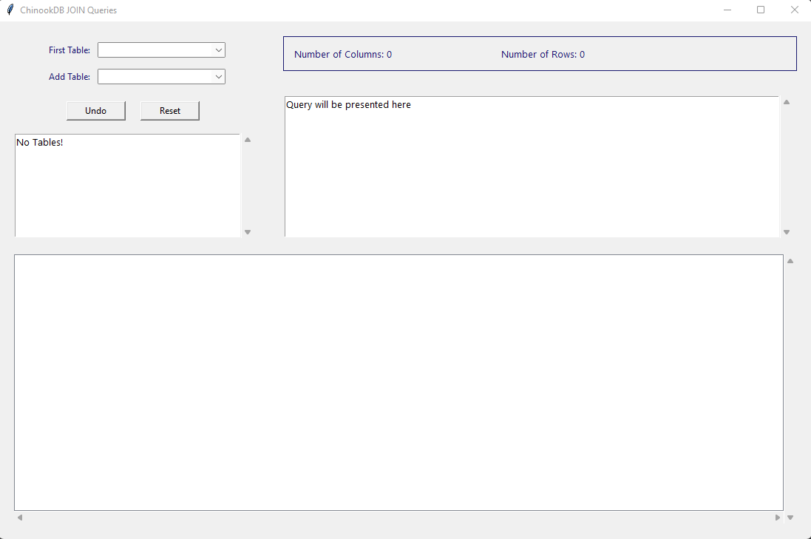
Overall look
All tables on DB
Presents number of rows and columns
Tables that may be added
Remove last added table
The Query
Resets query
All relations
Treeview

Slide 4
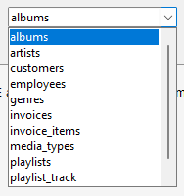
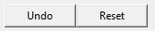

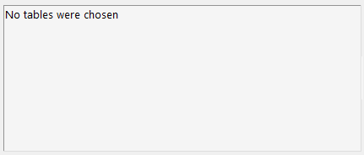
GUI Widgets
Combobox –
Listbox and Entry combined! Users may choose tables from the list
Button –
When configuring a button, we create command that supposed to happend when it will be pressed.
Scrollbar –
When the results contains more data than the widget’s size, we might want to use scrollbar – to be able to see the whole data.
Text –
May show all query’s text, can contain scrollbar

Slide 5
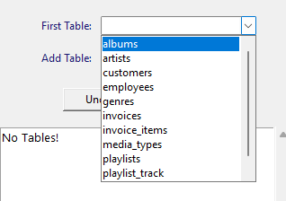
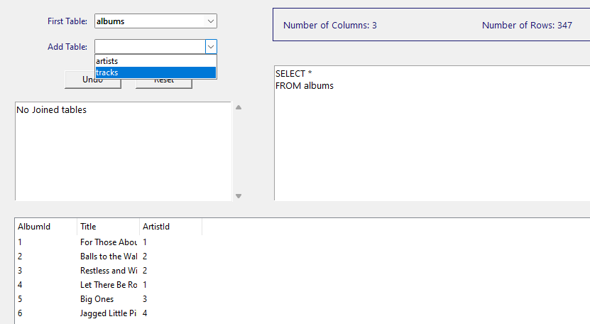
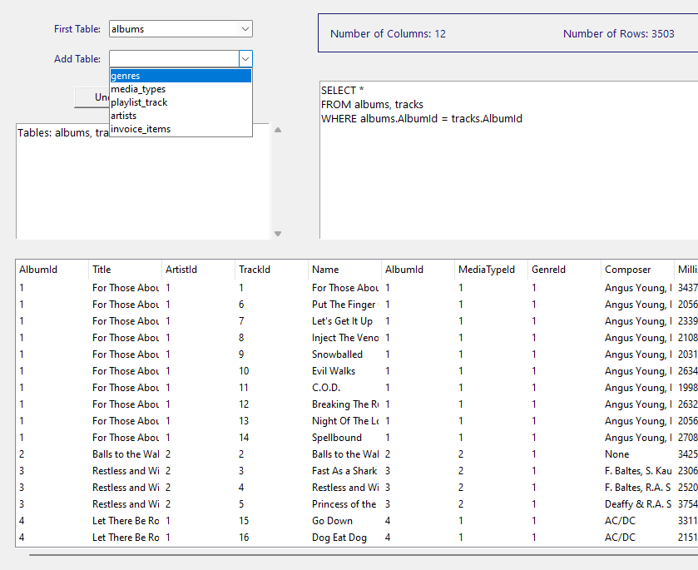
Adding tables
Adding first table
Adding another table
Current related tables
The result!

Slide 6
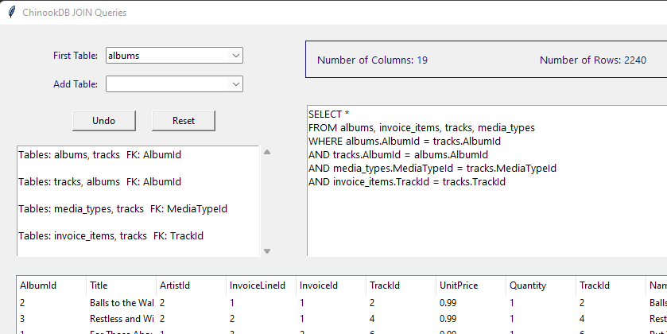
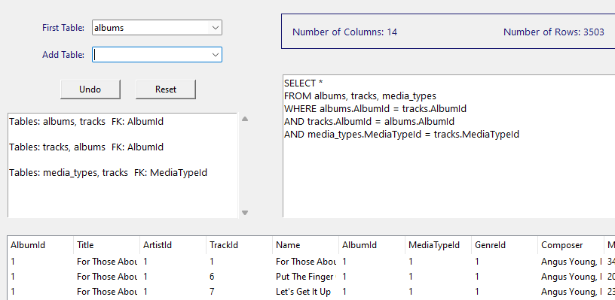
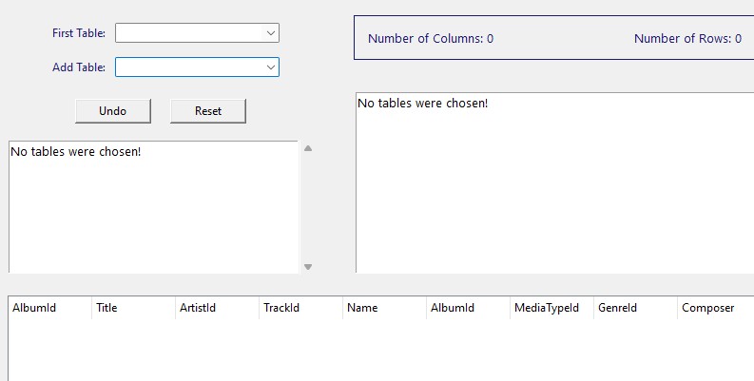
Undo & Reset for last added table
Reset
Undo last table
The result
** When we press “Reset” or “Undo” When no tables were chosen, it will behave like Reset and will not exit the program,

